Slide 1
Our favorite artists
小组成员：
佘添翼
谢弘扬
赵伯俣
张宇哲

Slide 2
CONTENTS
？？？
Qi Baishi
Famous Japanese animation director who has an irreplaceable position in the global animation industry.
the most prominent artist, calligrapher, and seal engraver in modern China
Michelangelo Buonarroti
添加标题
the most fsmous sculptor and painter and architect; one of the outstanding figures of the Renaissance
Geplis dipsam volorib vendian debist lignist quantium temab ium exper

Slide 3

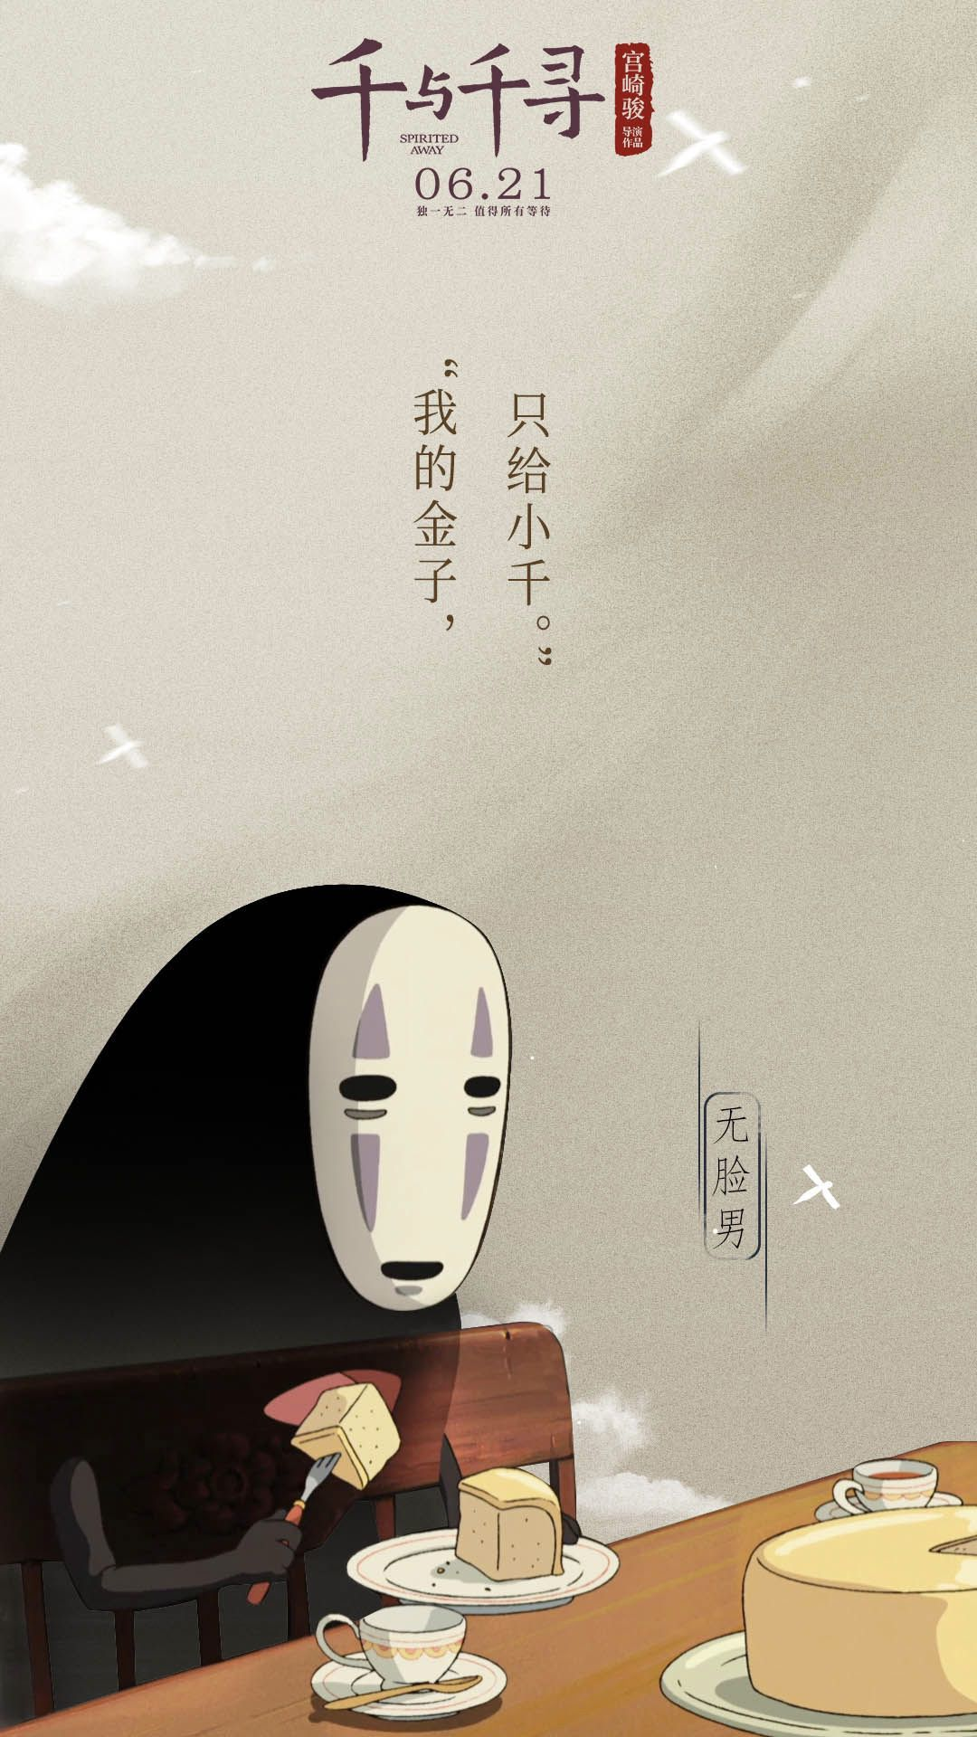


Slide 4
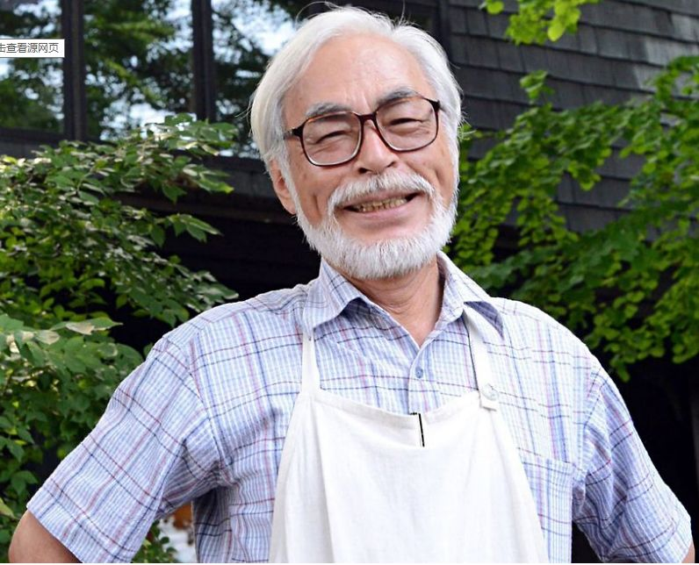
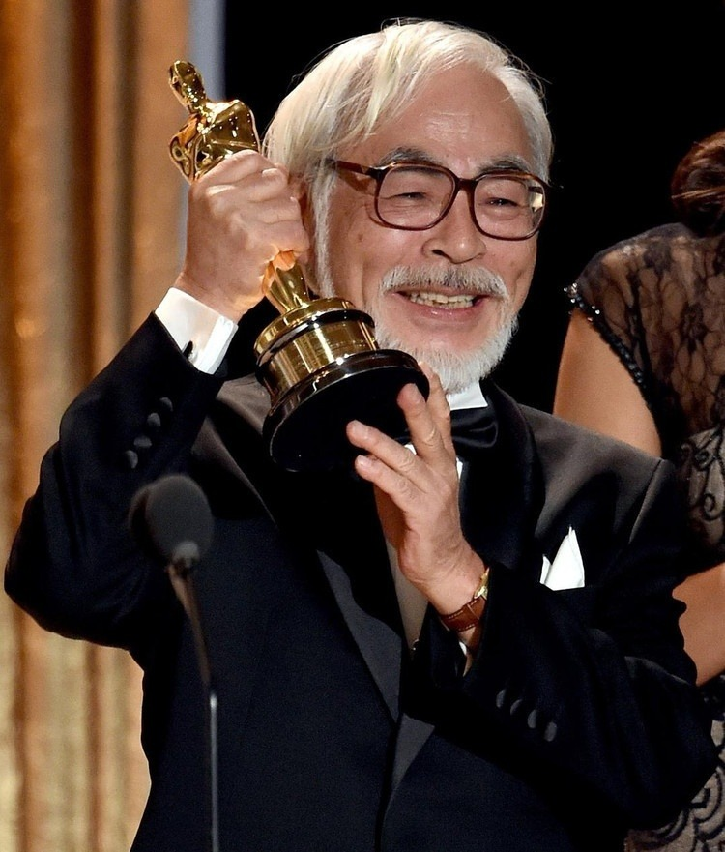
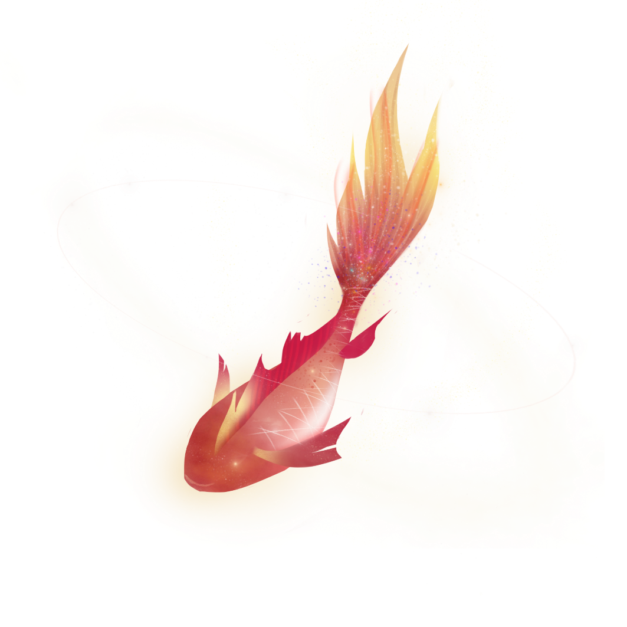
Hayao Miyazaki
INSPIRATIONS
Beauty is found everywhere. Our eyes do not show a lack of sense of beauty, but a lack of observation.
-Auguste Rodin

Slide 5
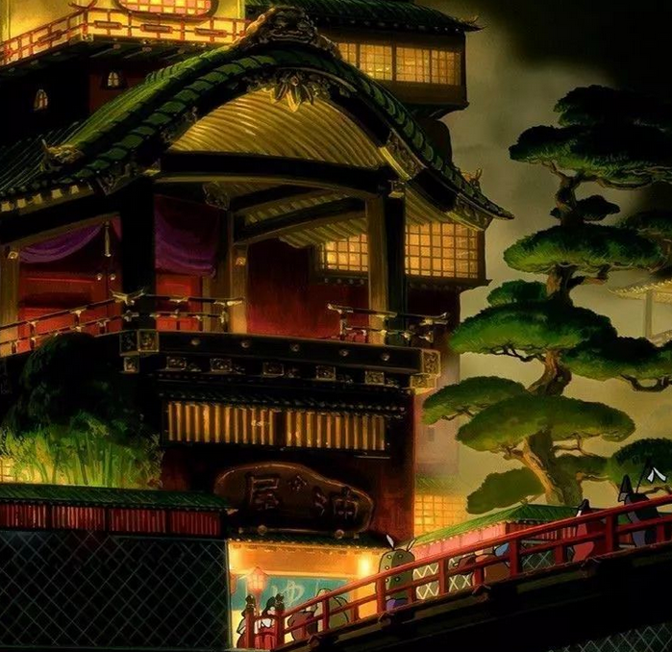
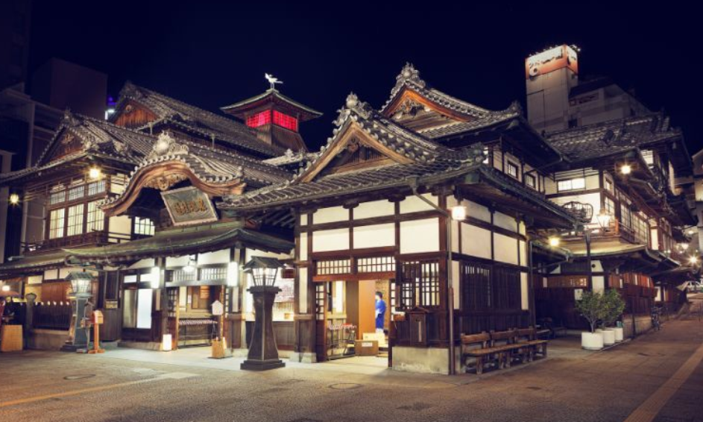

《千与千寻》" spirited away"
道后温泉

Slide 6
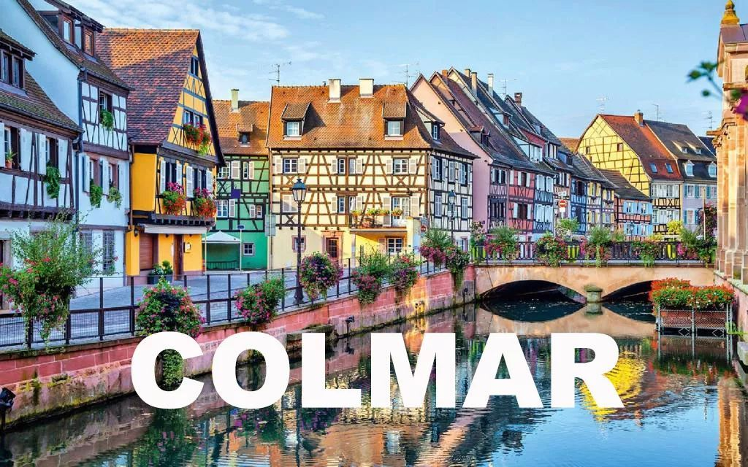
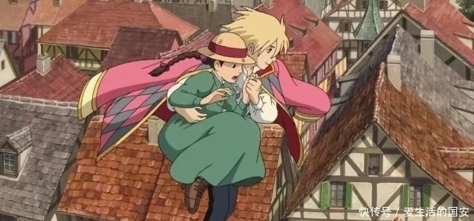
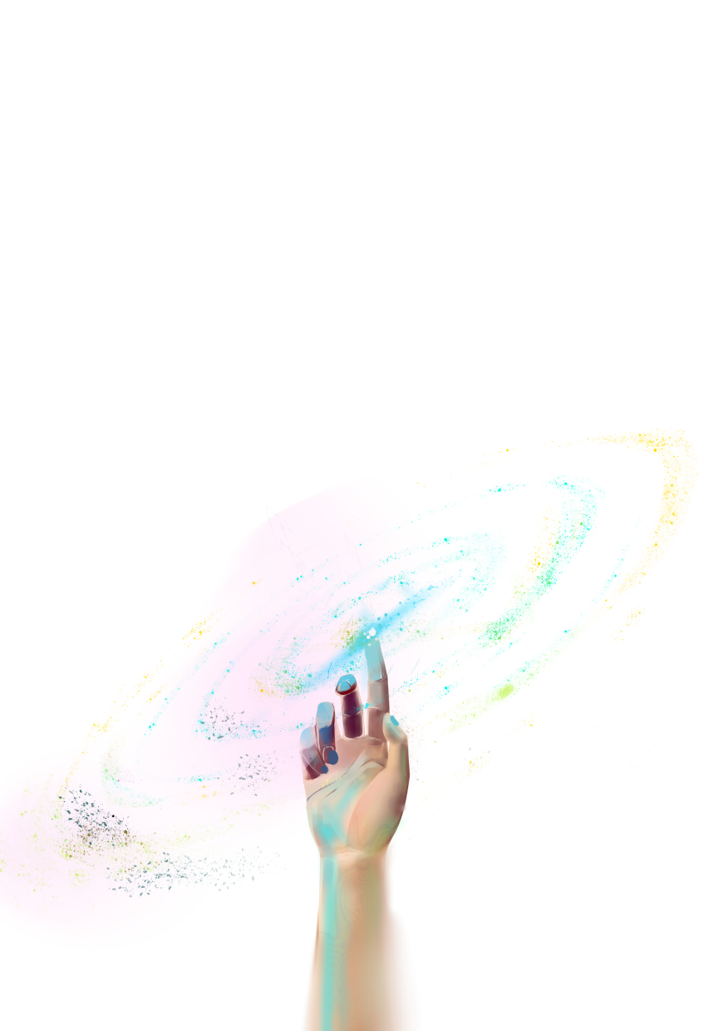
哈尔的移动城堡 "Hal's Castle"
Colmar in France

Slide 7
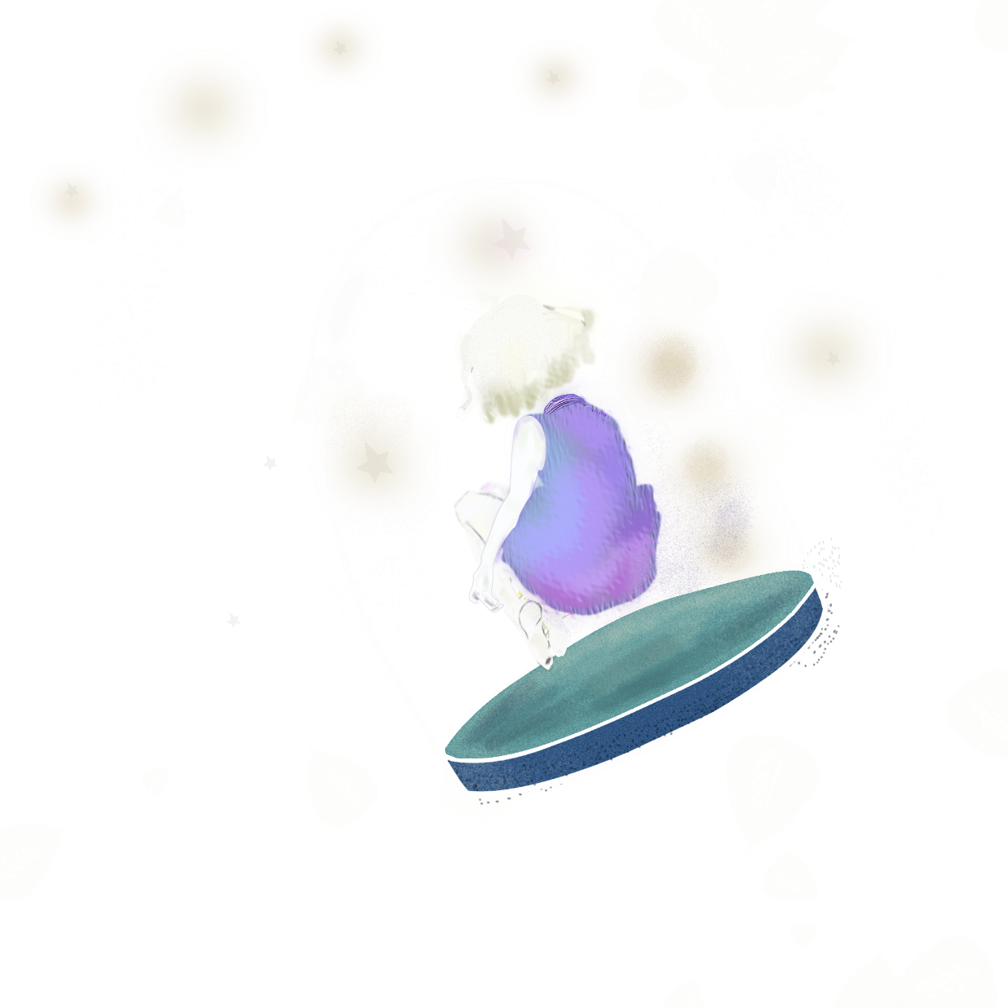
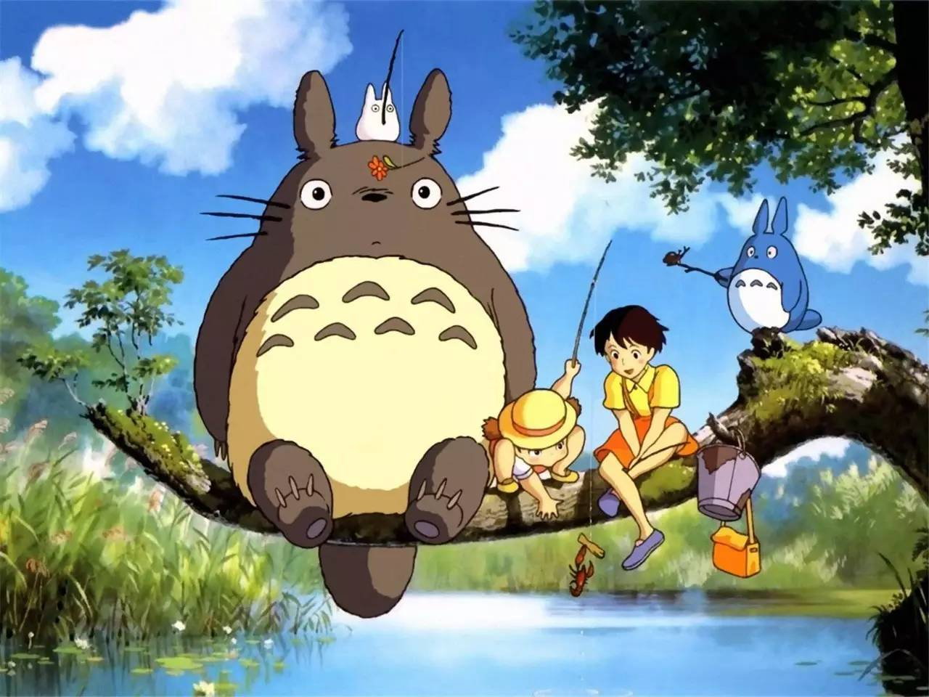
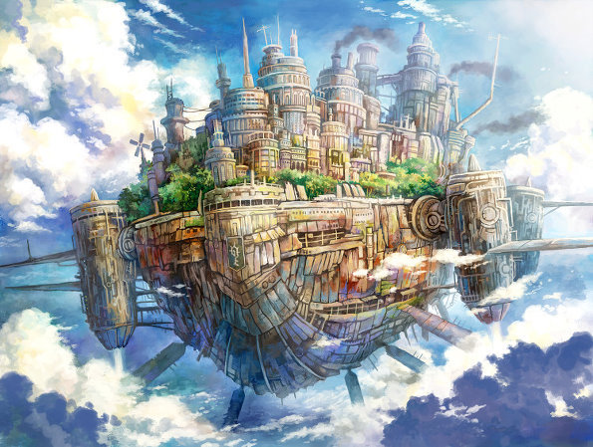
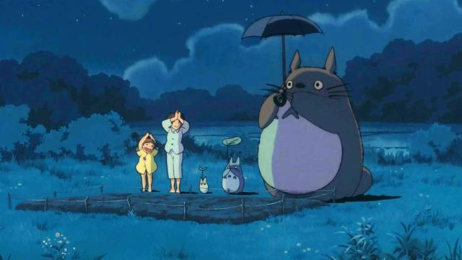
CONFIDENCE
"masters fail even more than beginners".
"chinchilla" and "city of the sky"
《龙猫》和《天空之城》

Slide 8
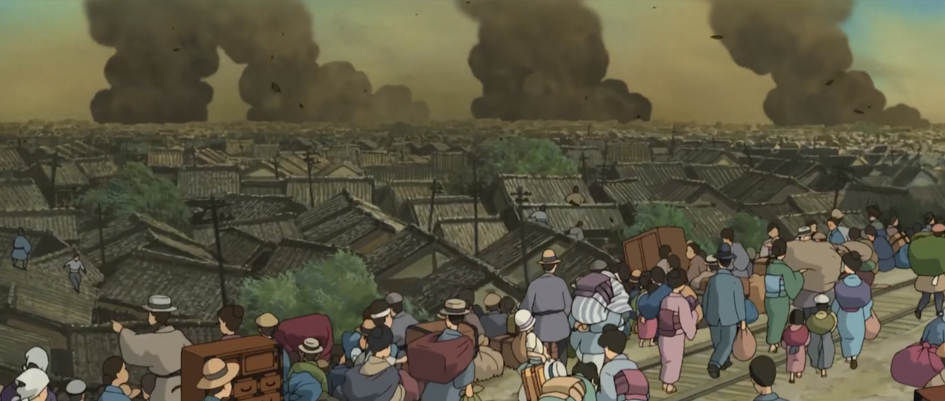
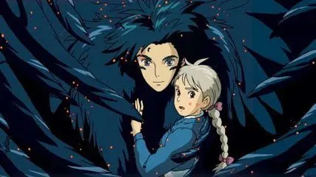
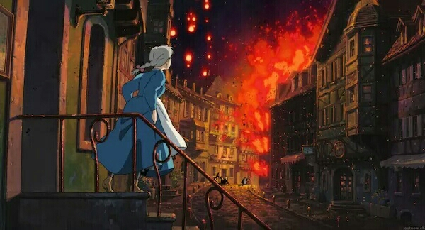
PEACE
the magician Hal refused the king's order to participate in the war, but defended the peace with his own strength, and finally calmed the war between the two countries.
This is the hero Hal and Sophie. Finally Sophie saves Hal. They have a sweet ending
“This world, will eventually need peace”

Slide 9
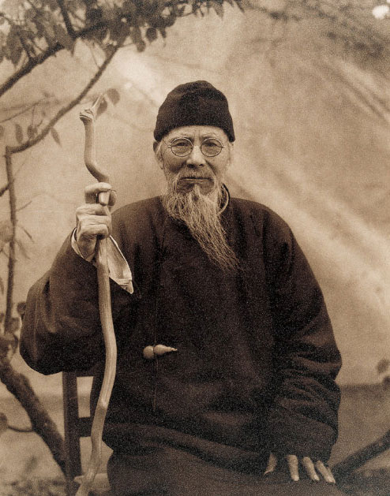
Part Two: QiBaishi
--A master of modern Chinese painting and a world cultural celebrity.

Slide 10
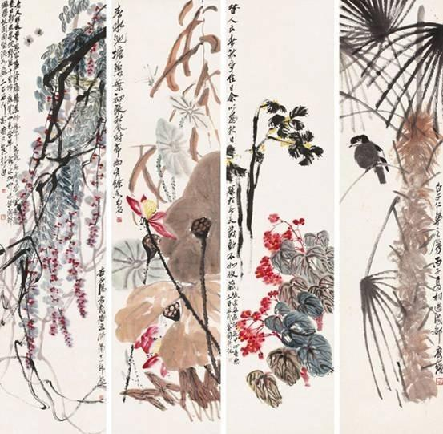
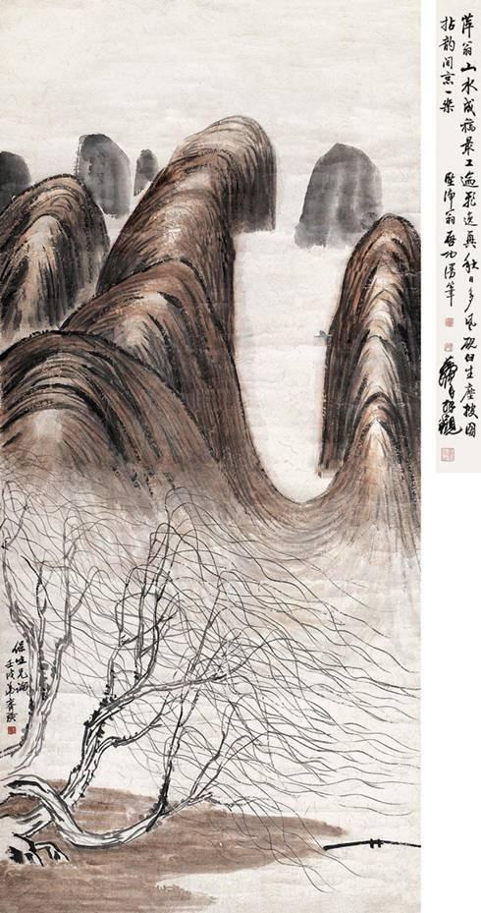
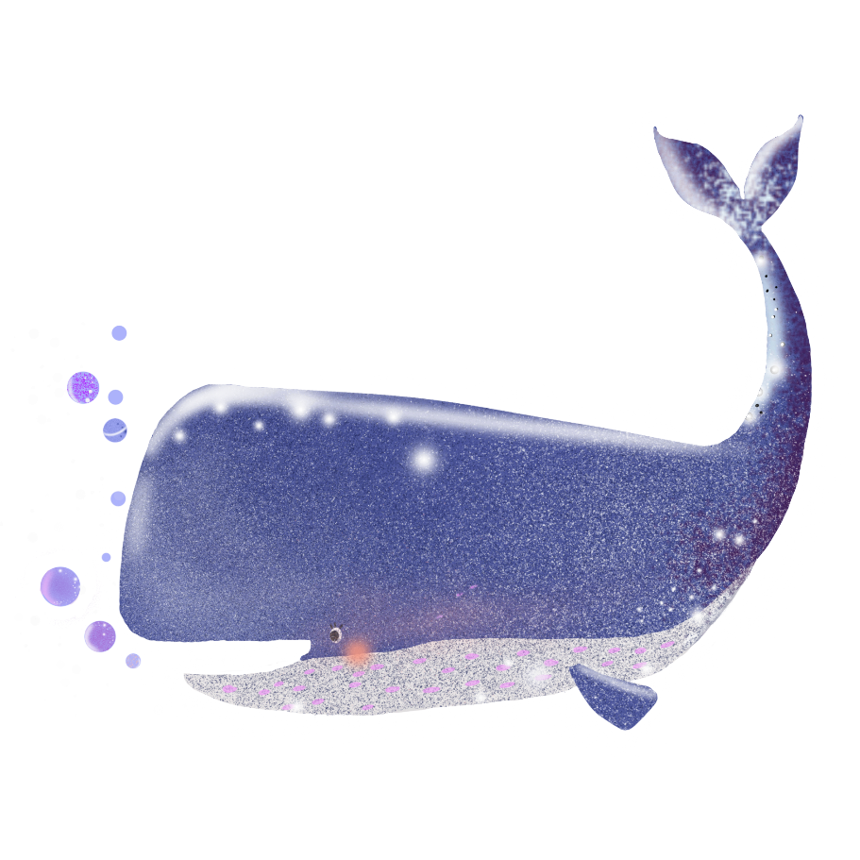
Famous Paintings of QiBaishi
《花卉四屏》
《秋山图》

Slide 11
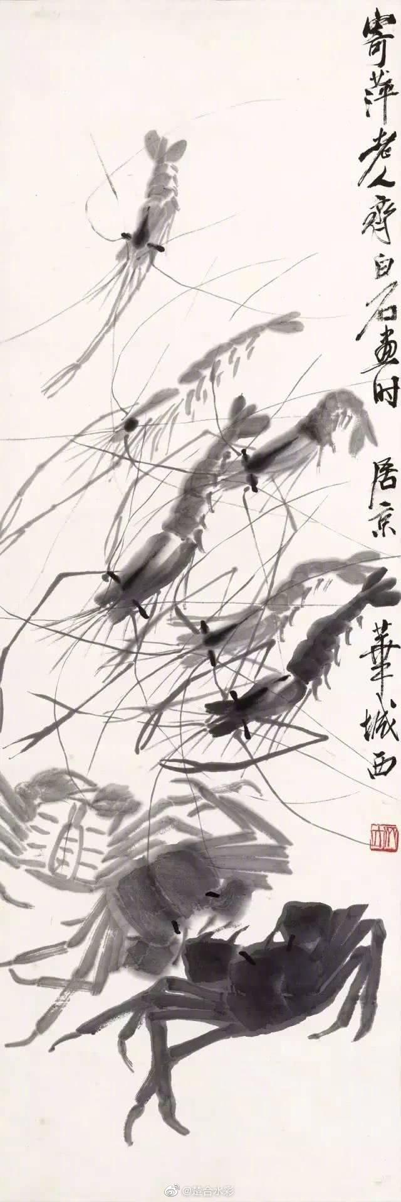
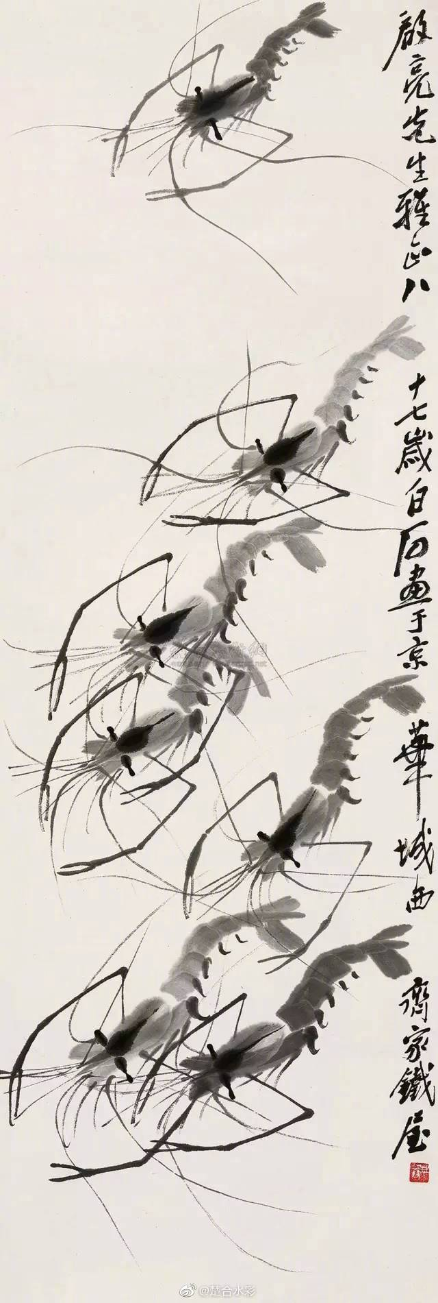
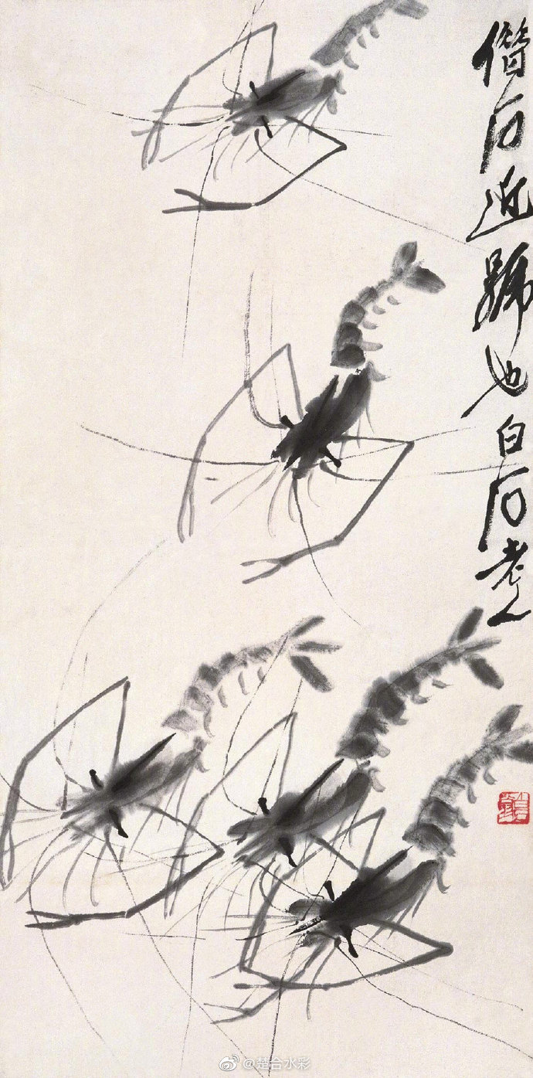
shrimp of QiBaishi

Slide 12
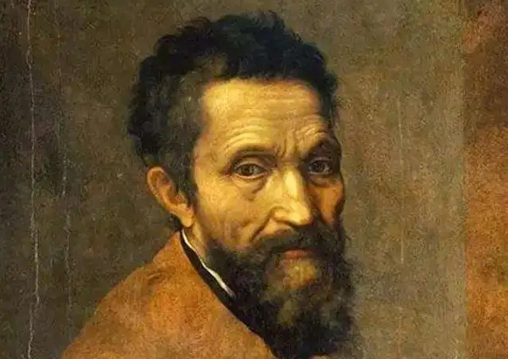
Part three: Michelangelo Buonarroti
Italian Renaissance period great painter, sculptor, architect and poet, Renaissance sculpture art peak representative

Slide 13
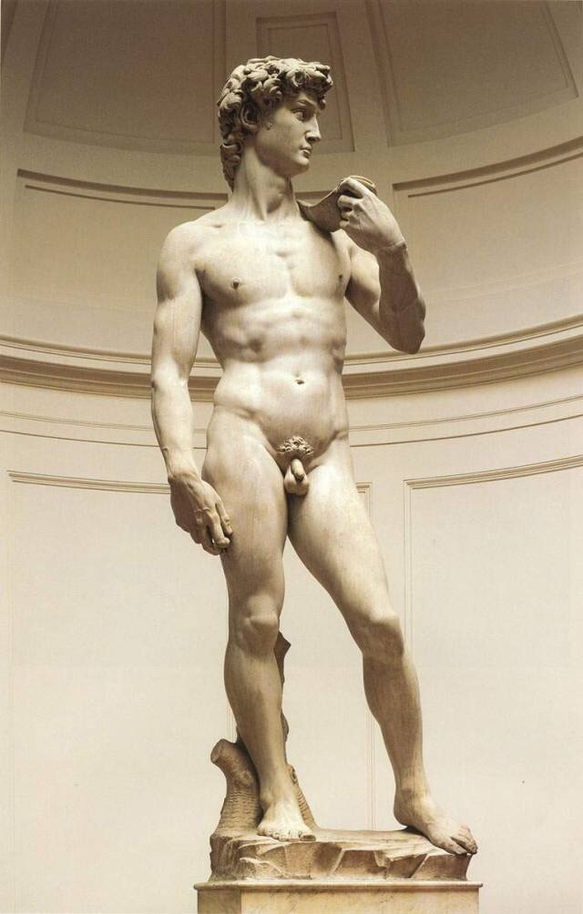
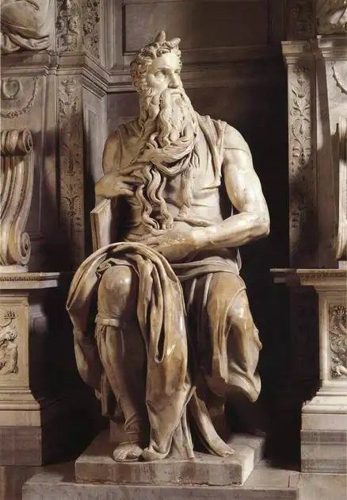
David
Moses
《》
《大卫》
《摩西》

Slide 14
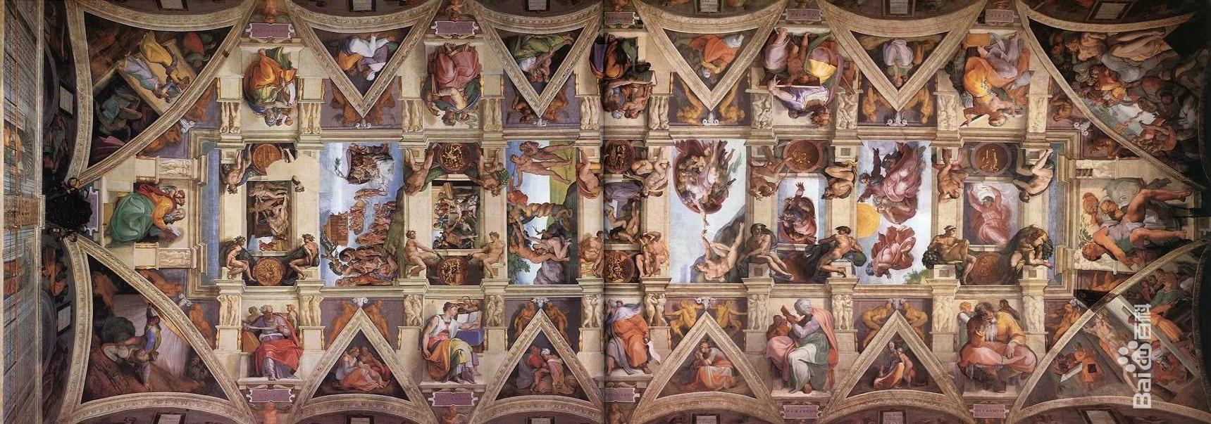
Genesis
《创世纪》

Slide 15
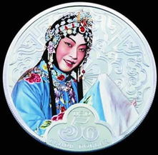
Part four：Mei Lan Fang
master of Chinese Peking opera performing arts.

Slide 16
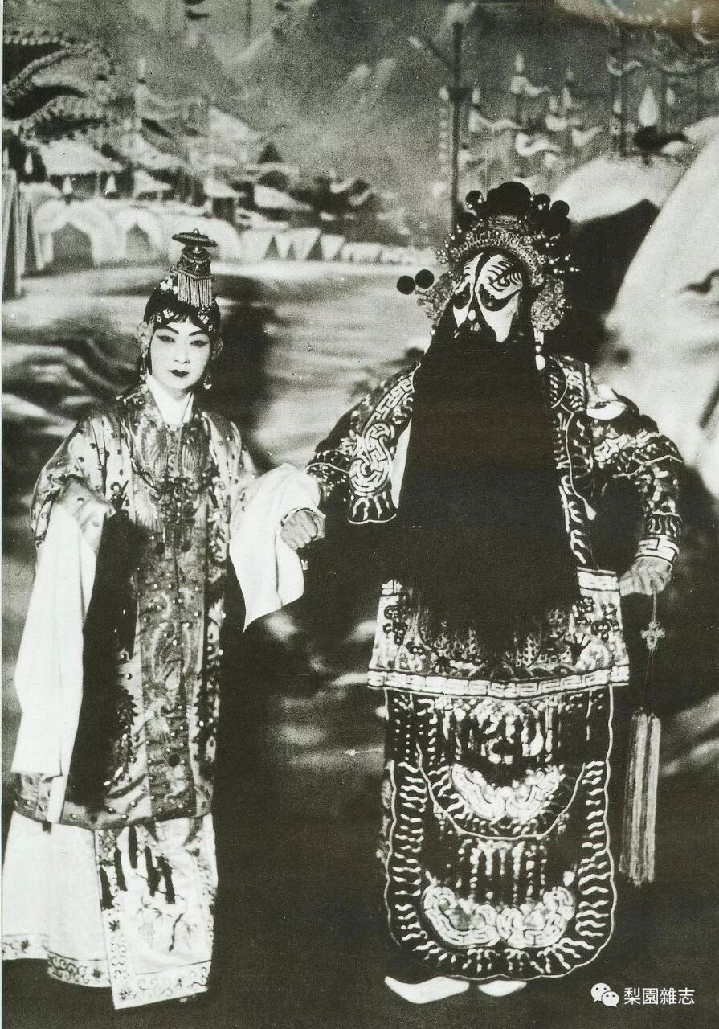
霸王别姬
Farewell my concubine, in the late Qin Dynasty, when Chu and Han fought, Xiang Yu was trapped under the ridge and heard the song of siege on all sides. He suspected that the Chu army had fallen to the Han Dynasty and drank goodbye to Yu Ji in the camp. Yu Ji committed suicide. Xiang Yu broke out of the siege and got lost. When she reached the Wujiang River, she felt shameless and killed herself by the river.

Slide 17
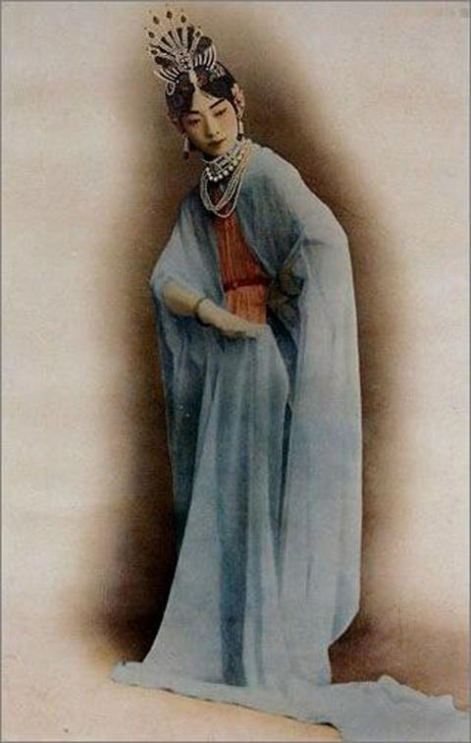
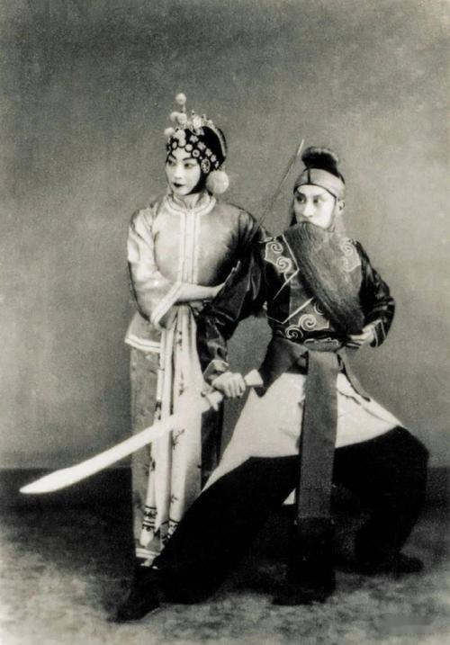
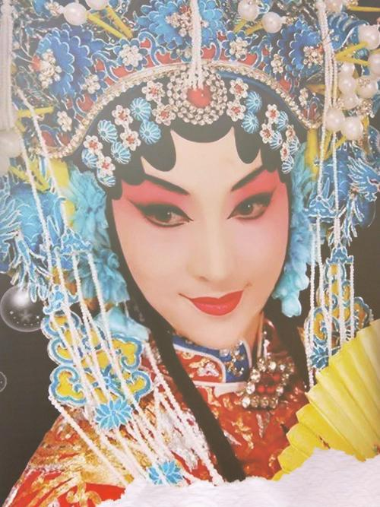
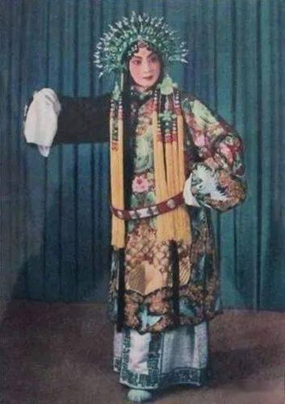
贵妃醉酒（The Drunken Beauty）
宇宙锋
打渔杀家
天女散花（the heavenly maids scatter blossoms）

Slide 18
感谢の观看
THANK YOU FOR WATCHING

